Slide 1










Happiness
In pursuit of

Slide 2
Agenda
1
Forewords
2
Meaning
3
Facts

Slide 3
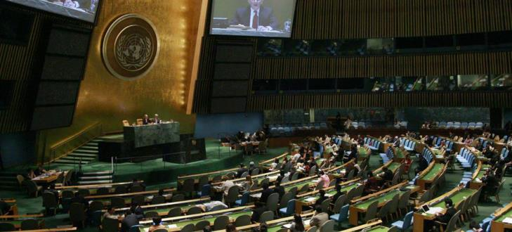
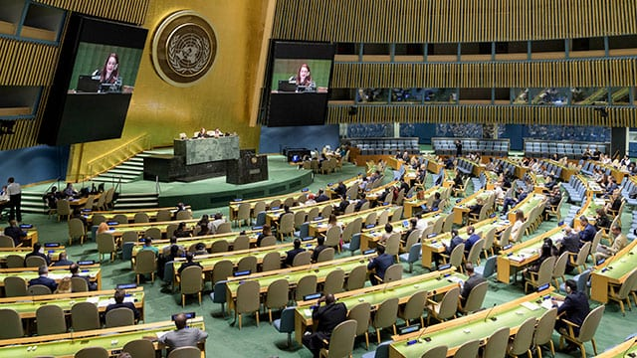
Agenda
1
The beginning...
The Bhutanese Resolution – July 19, 2011-GNH
“The pursuit of happiness is a fundamental human goal”
2
Tema 2
3
Tema 3
Notes:
https://en.wikipedia.org/wiki/Gross_National_Happiness
The General Assembly today called on United Nations Member States to undertake steps that give more importance to happiness and well-being in determining how to achieve and measure social and economic development.
In a resolution adopted without a vote, the Assembly invited countries “to pursue the elaboration of additional measures that better capture the importance of the pursuit of happiness and well-being in development with a view to guiding their public policies.”
The resolution said “the pursuit of happiness is a fundamental human goal” and embodies the spirit of the globally agreed targets known as the Millennium Development Goals (MDGs).
Member States also welcomed the offer of Bhutan, which for many years has used gross national happiness rather than gross domestic product (GDP) as a marker of success, to convene a panel discussion on the theme of happiness and well-being during the Assembly’s next session, which begins in September.
The resolution notes that the GDP indicator “was not designed to and does not adequately reflect the happiness and well-being of people in a country,” and “unsustainable patterns of production and consumption can impede sustainable development.”
Meanwhile, the Assembly today also adopted a resolution stressing the importance of equality among the six official UN languages – Arabic, Chinese, English, French, Russian and Spanish.

Slide 4
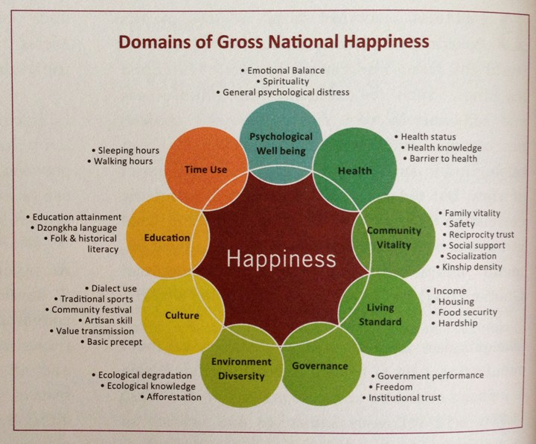
GNH CONCEPT

Slide 5
Ten Most Significant World Events (1/3)
2015
2016
Refugee Crisis Rois Europe
ISIS Terrorists Strike on Three Continents.
Negotiations on Iran’s Nuclear Program Produce a Deal.
The EU Rebuffs Greece’s Demand for Austerity Relief.
The Trans-Pacific Partnership Finally Gets Done.
Russia Intervenes in Syria.
The World Strikes a Deal on Climate Change.
China Devalues the Renminbi Amidst an Economic Slowdown
China Builds Islands in the South China Sea
Saudis Intervene in Yemen
Donald Trump wins the U.S. Presidency.
Russia interferes in the U.S. Presidential Election
Britain Votes to Leave the European Union
North Korea Conducts Missile and Nuclear Tests.
The Trans-Pacific Partnership Flops
Rodrigo Duterte Becomes President of the Philippines.
The Coup in Turkey Fails.
Eastern Aleppo Falls.
Brazil and South Korea Impeach Their Presidents.
Colombia Strikes a Peace Deal
Notes:
https://www.cfr.org/blog/ten-most-significant-world-events-2015
https://www.cfr.org/blog/ten-most-significant-world-events-2016

Slide 6
Ten Most Significant World Events (2/3)
2017
2018
Donald Trump Champions America First.
Xi Jinping’s “Extraordinary Elevation.
North Korea Defies the World.
The Globe Continues to Warm.
Global Growth Picks Up.
Mohammad bin Salman Remakes Saudi Arabia.
The Fall of Mosul.
The Rohingya Crisis.
Britain Triggers Article 50
Robert Mugabe’s Ouster.
Trump Triggers a Trade War and More
The Weakening of the West Worsens.
Dire Warnings About Climate Change Mount.
The United States Leaves the Iran Nuclear Deal
The Murder of Jamal Khashoggi.
#MeToo Movement Goes Global.
Trump’s Summitry Alarms Friends and Delights Foes
Ethiopia Signs a Peace Deal with Eritrea.
Humanitarian Crises Deepen.
Democrats Win Back the House
Notes:
https://www.cfr.org/blog/ten-most-significant-world-events-2017
https://www.cfr.org/blog/ten-most-significant-world-events-2018

Slide 7
Ten Most Significant World Events (3/3)
2019
2020
Protestors Take to the Street. “The Year of Protests”
The U.S. House Impeaches President Donald Trump.
The United States Ends Its Support for the Syrian Kurds
India Embraces Hindu Nationalism.
The Amazon Burns.
Tensions Flare in the Persian Gulf.
The Central American Migrant Exodus Grows.
The U.S.-China Trade War Continues.
Brexit Upends British Politics.
North Korea-U.S. Nuclear Talks Stall.
Are we going to be happy in 2020?
Notes:
https://www.cfr.org/blog/ten-most-significant-world-events-2019

Slide 8
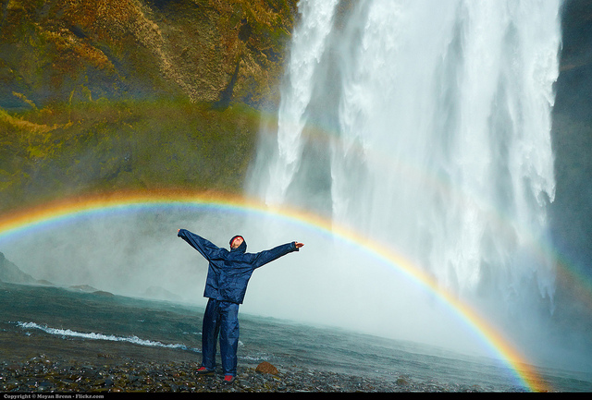
2019 : Environment for happiness
Social environment,
Happiness in cities and rural areas,
Natural environment,
Happiness and sustainable development

Slide 9
‘Well-Being and Happiness: Defining a New Economic Paradigm’
Generosity
Freedom
GDP er Capita
Family
Tecnology
Corruption
Generosity

Slide 10




Slide 11
Freedom
To take your own choices

Slide 12
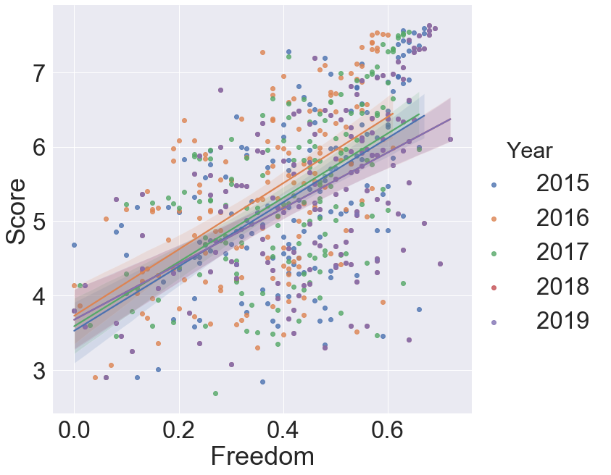
Freedom

Slide 13
Corruption
Lack of confidence in the government

Slide 14
GDP per capita
Write how it affects to population-
World extreme income high and low with (icons)

Slide 15
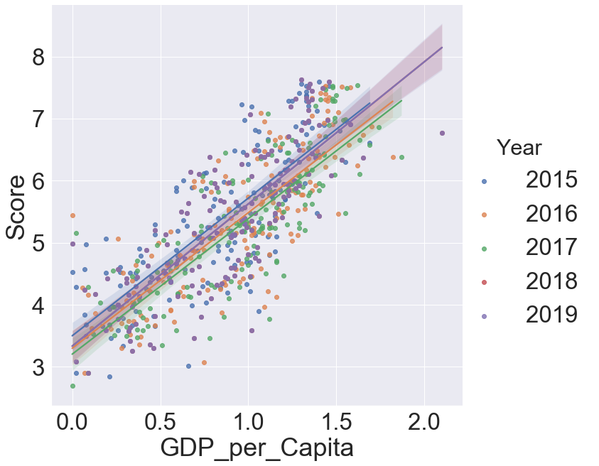
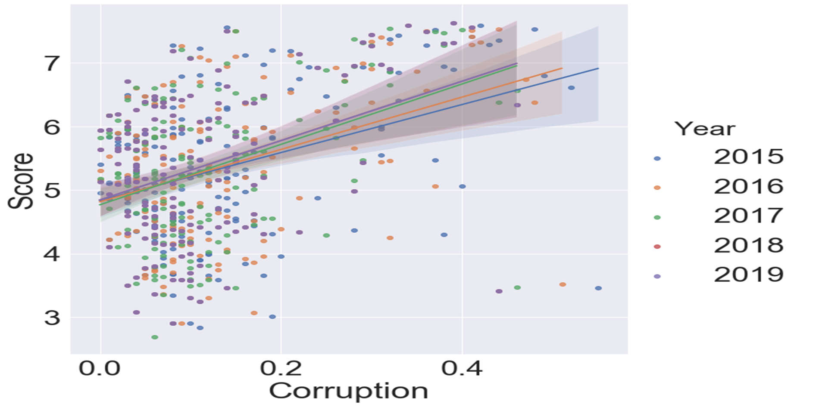
GDP per capita
Corruption

Slide 16
Generosity
Sense of community

Slide 17
Life
Expectancy
Write about factors- how this is related to wellbeing

Slide 18
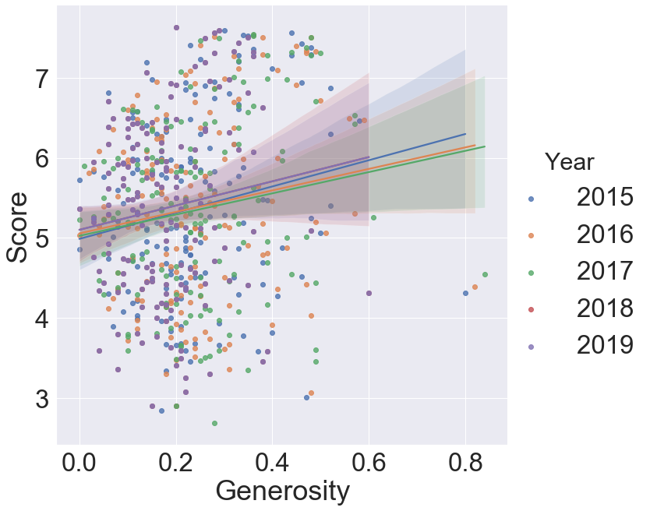
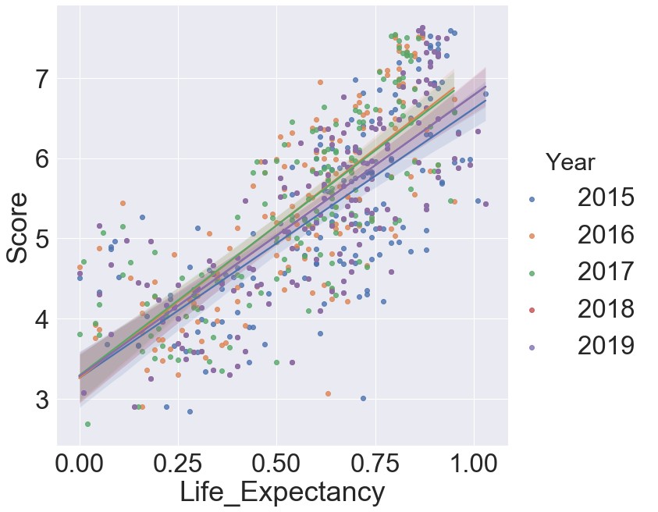
Generosity
Life Expectancy

Slide 19
Analysis per Region
North America
Africa
Latin America and Caribbean
Western Europe
Middle East
Southeastern Asia

Slide 20
Limitations and Constraints
How was it possible to get data in war thorn areas? If successful, did they get enough data for it to be a valid sample?

Slide 21
Resources
Kaggle: https://www.kaggle.com/unsdsn/world-happiness
https://data.world/laurel/world-happiness-report-data
https://www.cfr.org/blog/ten-most-significant-world-events-2015
Databases
API

Slide 22
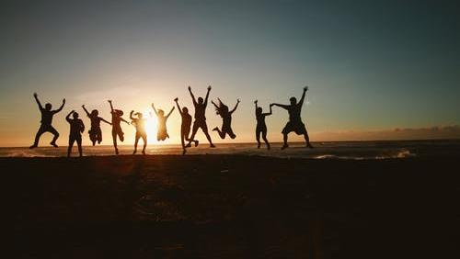
“The perfect human being is all human beings put together, it is a collective, all of us together that make perfection.“
Socrates

